Slide 1
5th
September 22, 2021
San Beda University , Manila
Biennial Convention and Oath taking Ceremonies
“Forging Local and Global Partnerships towards Sustainable Initiatives”
PAEPI-GLOBAL
QUICK HISTORY AND ORGANIZATIONAL STRUCTURE
Prof. Angelica M Baylon, PhD
PAEPI Global Chair Emeritus/Past President 2009-2014

Slide 2
Fast facts about PAEPI
1989 - founded by President Dr. Cristeto Bonilla (RIP), TUP Manila,(SEC 17720)
Re-registered with SEC 10059 on July 1, 2009 , address in MAAP Bataan
( Ref: Minutes of the PAEPI Board & National Planning ,MAAP ,May 2009 )
Recognized professional association, membership consists of responsible officials &
extension implementers in various accredited institutions namely:
NGOs and NGAs
HEIs
LGAs and LGUs
Private companies
Global partners
Conduct of professional development activities & projects for the enhancement of its members’ competencies
Consist of individual & institutional members in collaboration with global reputable partners. Hence PAEPI-GLOBAL

Slide 3
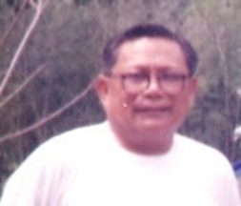
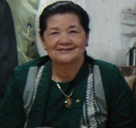
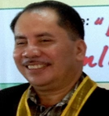
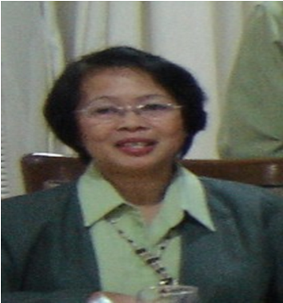
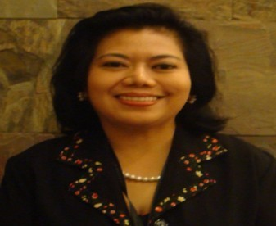
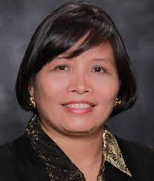
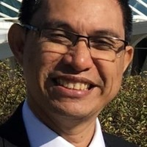
Past and Present PAEPI Presidents
Dr. Cristeto Bonilla
Atty. Anita Chauhan, PhD
Dr. Aladino Lecio
Dr. Estelita Tucay
Pioneer President,
AY1989-1999
2nd President,
AY2000-2002
3rd President,
AY2003-2004
4th President,
AY2004-2008
Director TUP, Manila, NCR
VP , NEUST, Region 3
CHR Director , Region 1 in 2003
VP CapSU, Region 6
Director NVSU, Region 3
Prof. Angelica M. Baylon,PhD
Atty. April Amihan Alcazar, PhD
Prof. James Loreto Piscos, PhD
5th President,
AY2009-2014
6th President,
AY2015-2021
7th President,
AY2022-2023
Director MAAP, Bataan, Region 3
President, PLP, Pasig, NCR
San Beda University, NCR

Slide 4
PAEPI GLOBAL Governing Board
Vice Chair
Secretary
PRO
Exec. Dir/Treasurer
Chair
DR. CRISTINA DRAGOMIR
DR. RYO TAKAHASHI
DR. TATIK
SURYANI
DIR. WARREN NEVAD
DR. JAMES LORETO PISCOS
Constanta Maritime University, Romania
Sendai University,
Japan
UHW (formerly STIE Perbanas), Indonesia
UT & TREEDC, USA
San Beda University, Philippines

Slide 5
PAEPI GLOBAL BOARD OF DIRECTORS
Asia Pacific and Oceania
DR. SAMRAT GHOSH
DR. K. KARTHIK
DR. SANDA NAING
PROF. OLGA O. TISHCHENKO
University of Tasmania, Australia
AMET University, Chenai, India
Myanmar Maritime University, Myanmar
Far Eastern State Technical Fisheries University, Russia
DR. REDZUAN ZOOLFAKAR
DR. RAY YEN
DR. RAMHARI LAMICHHANE
UniKL Marine Institute of Marine Engineering Technology, Malaysia
National Taiwan Ocean University
Taiwan
Asia Pacific Accreditation & Certification Commission
Nepal

Slide 6
PAEPI GLOBAL BOARD OF DIRECTORS
Europe
DR. BORIS
SVILICIC
CAPT. MOHAMED S. ROWIHL, MsC
DR. TEONA DZNELADZE
DR. NIKITAS
NIKITAKOS
University of Rijeka, Croatia
Arab Academy for Science, Technology and Maritime Transport, Egypt
Batumi State Maritime Academy, Georgia
University of the Aegean,
Greece
DR. ROSA MARIA SPITALERI
DR. MARIANA
PANAITESCU
DR. PAVEL KOVALISHIN
Istituto per le Applicazioni del Calcolo,
Italy
Constanta
Maritime
Academy,
Romania
Kaliningrad State Technical University , Russia

Slide 7
PAEPI GLOBAL BOARD OF DIRECTORS Americas
DR. MARIE LEINER
DR. ROBERTO E. LASTRA MIER
Texas Tech University Health Sciences Center,
Texas, USA
Universitaria de la Costa CUC, Colombia

Slide 8
PAEPI GLOBAL
Executive Officers
PROF. JAMES LORETO PISCOS
DR. BERT J. TUGA
DR. JOSELITO F. VILLARUZ
DR. ANTHONY S. PENASO
(San Beda University)
(PNU President)
(WVSU President)
(CSU President)
President
Vice President for Luzon/Exec. VP
Vice President for Visayas
Vice President for Mindanao
DR. ROWENA E. JAVIER-RIVERO
DR. JOSE M. BARLIS, JR
ENGR. PAUL GERALD LASANGRE CRUZ
(San Beda University)
(PUP-Bataan)
(Laguna University)
Secretary
Treasurer
PRO

Slide 9
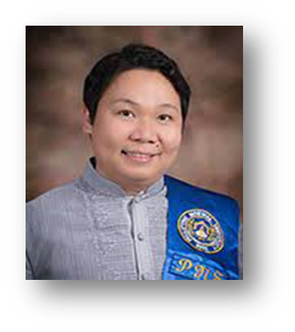
PAEPI GLOBAL
LUZON BODs
DR. BERT J. TUGA
DR. MANUEL M. MUHI
DR. EVA MARIE C. DUGYON
DR. DEXTER R. BUTED
(PNU President)
(PUP President)
(IFSU President)
(PSA President)
Vice President for Luzon/NCR
Asst. VP for Luzon/NCR
CAR
REGION I
DR. URDAJAH A. TEJADA
DR. CECILIA N. GASCON
DR. RAMON M. DOCTO
DR. ALBERTO N. NAPERI
(CSU President)
(BSU PRESIDENT)
(PSU PRESIDENT)
(CBSUA PRESIDENT)
REGION II
REGION III
REGION IV
REGION V

Slide 10
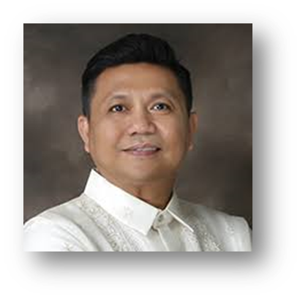
PAEPI GLOBAL
VISAYAS BODs
DR. JOSELITO F. VILLALUZ
DR. RAUL F. MUYONG
(WVSU President)
(ISATU President)
Vice President for Visayas
Asst. VP for Visayas/REGGION VI
DR. VICTOR C. CANEZO, JR
DR. REGUCIVILLA POBAR
(BPSU PRESIDENT)
BILIRAN, REGION VIII
(BISU President)
BOHOL, REGION VII

Slide 11
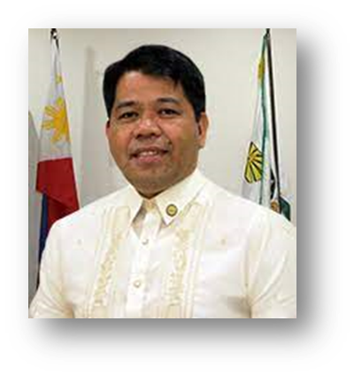
PAEPI GLOBAL
MINDANAO BODs
DR. ANTHONY S. PENASO
DR. MARY JOCELYN V. BATTUNG
DR. LOURDES GENERALAO
(CSU President)
(JHCSC President)
(USP President)
VP for Mindanao/
CARAGA
REGION IX
REGION X1
DR. CHARISMA
S. UTUTALUM
DR. ROLANDO HECHANOVA
DR. GLENN HERBERT P. REYES
(SSC President)
(SKSU President)
(NMCST President)
Asst. VP for Mindanao/
ARMM
REGION XII
REGION X

Slide 12
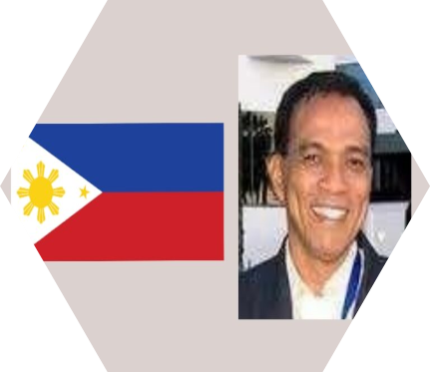
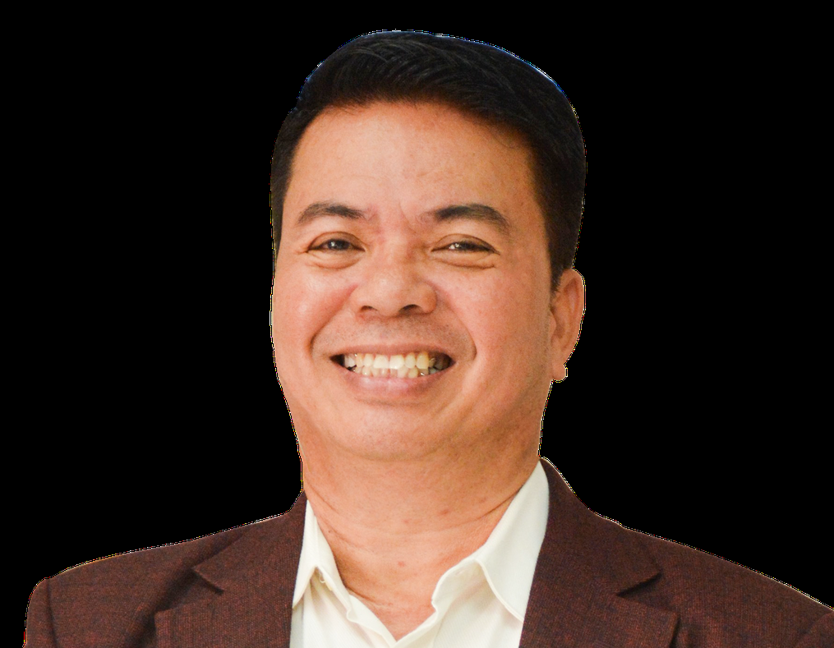
PAEPI GLOBAL
Special Committee Chairs
Membership
Publication
Marine Education & Ocean Literacy
Legal and Policy
Technical and Engineering
DR. TSUYOSHI SASAKI (President, AMEA)
DR. VIVEK JAIN (Barrister)
DR. MICHELE FIORINI
CHANCELLOR
DR. RAJESH ARORA
DR. DJUWARI
(President, IASPER)
Tokyo, Japan
England
Roma, Italy
India
Surabaya, Indonesia
DR. Charlito P. Cadag
DR. MILABEL ENRIQUEZ-HO
DR. MARIE PAZ E. MORALES
DR. JIMMY T. MASAGCA
President Camarines Sur Polytechnic Colleges
Catanduanes State University
AACUP Exec. Director
Chair, NRCP Division 1
PNU Director , Pub Office
DR. MILABEL ENRIQUEZ-HO

Slide 13
PAEPI GLOBAL
Board of Advisers
PROF. BHARAT SONI, PhD
VADM EDUARDO MA R SANTOS, AFP (RET)
President/CEO
Global Linkage and Alliance
President,
Maritime Academy of Asia and the Pacific
USA
PHILIPPINES
DR. MILABEL ENRIQUEZ-HO
PROF. JIMMY T. MASAGCA
AACUP Exec. Director
Catanduanes State University

Slide 14
P-A-E-P-I
CORPORATE VALUES AND ETHICS
P
Productivity (Commitment to Action & Outputs)
Remarkable Acronyms
B-E-N-E-D-I-C-T
S-B-U
(fearless and
confidence)
A
Accountability (Responsible, Transparency & Teamwork for good governance)
E
Ethical Conduct (Principled, Decent , Just and proper action & professionalism at all times )
P
Pride (Consistent as PAEPI Member (PAEPIan) in Good Standing)
Rev. Fr. Aloysius Ma. A. Maranan, OSB
First Rector-President , San Beda University (2018 to data)
22nd Rector-President of then San Beda College ( 2010-2018)
Communication
I
Integrity (Reliable , Honorable & Honest)
(Coach)
3Cs
of a
PAEPIan
Collaboration
Cooperation
(Collaborator)
(Comrade)

Slide 15
VISION
PAEPI is a leading professional association on research-based extension programs in the Philippines & in the Asia Pacific Region & Beyond ,
through Global partnerships.
MISSION
PAEPI advances & advocates the professionalization of Extension Program Implementers as a career & as a service provider in four (4) development areas:
* Socio-welfare;
* Socio-economic;
* Environmental; and
*Infrastructure /Technology for innovation, productivity, and sustainability.

Slide 16
PAEPI
Extension is one of the important
trilogy functions of HEIs.
EXPANDED VISION
Extensionists as agents of change.
They process the appropriate knowledge, attitudes, skills, and practices (KASPs) to effectively perform
Capability building of extensionists is a continuous process.
They must think and act as professionals and should be well-versed in the accepted theories and practices of their job.
PAEPI envisions elevating extension to the level of discipline so that its practitioners, the extensionists, become well-equipped in the science and art of extension and to become wholly integrated professional extensionists.
How?
by continuous research and capability building that will contribute significantly to the development of professional extensionists.

Slide 17
PAEPI
Goals and General Objectives
PAEPI as key player or catalyst of 5Ps
for People Empowerment for SD …
General Objectives
Elevate extensions to a level of discipline vital to effective individual and social transformation.
01
Build and upgrade the capabilities and professionalism of the extension program
02

Slide 18
PAEPI 10-Point S-T-R-A-T-E-G-I-E-S
S
Social Mobilization and Program Complementation
Expansion of Memberships
E
T
Trainings and other Activities
Global Partnerships
G
R
Resource Generation
Involvement thru Policy & Media Advocacies
I
Appropriate Technology Promotion, Transfer & Utilization
Expertise Directory of all members and partners for networking & complementation
A
E
T
Twinning and Linkaging
Sharing thru participatory planning, consultations, and values orientation
…
S
5th
Biennial Convention and Oath taking Ceremonies
“Forging Local and Global Partnerships towards Sustainable Initiatives”

Slide 19
PAEPI Programs and Projects
R
RESEARCH - Undertake funded relevant & responsive research-based extension
E
EXTERNAL LINKAGES - Establish partnerships & collaborative activities with local & global institutions and orgs
S
SPECIAL PROJECTS - Develop , conduct , and evaluate special community projects aligned
P
PUBLICATIONS -Publish newsletters, souvenir programs, monographs, handbooks, pamphlets, journals & other materials on extension.
E
ENDORSEMENT – endorse policies by advocating , recommending , endorsing , and implementing policies
CAPACITY BUILDING- Conduct institutional, regional, provincial, & global training & seminar workshops for capability on extension; partnership with HEIs in offering diploma & graduate courses in Extension Management; distance education & short term courses in selected extension areas, based on the expertise of PAEPI members/ partners;
C
T
TALK or CONSULTANCY- Talk , discuss and support to further strengthen the extension programs of members & partner institutions
5th
Biennial Convention and Oath taking Ceremonies
“Forging Local and Global Partnerships towards Sustainable Initiatives”

Slide 20
PAEPI Global Partners
AUSN
for Masters and Phd full/partial scholarships on Global Public Health , Bioethics and sustainability, partnerships on Bioethics, Peace , human rights and Youth Peace Ambassador conferences
CERS, FESTFU, GLINK, MASCOT/IMACS, RI, STIE
for joint seminar and conferences /webinars and/or student contests
AMEA
GlobalMET, NI and IMarEST
for MET wherein free slots are provided for maritime member institutions for the capability training of their human resources
for marine education and ocean literacy partnerships and scholarships
BHS, South Korea
TREEDC
linking member institutions like BPSU for the English Training Program for Koreans
for renewable energy
5th
Biennial Convention and Oath taking Ceremonies
“Forging Local and Global Partnerships towards Sustainable Initiatives”

Slide 21
PAEPI Local Partners
CHED
PN
And
many
More…
CHR
DEPED
NRCP-DOST
DOE
5th
Biennial Convention and Oath taking Ceremonies
“Forging Local and Global Partnerships towards Sustainable Initiatives”

Slide 22
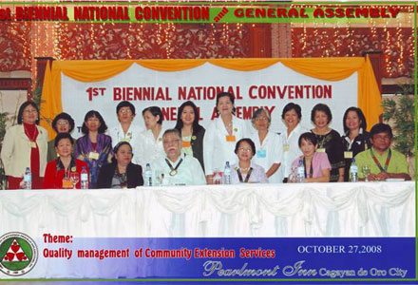
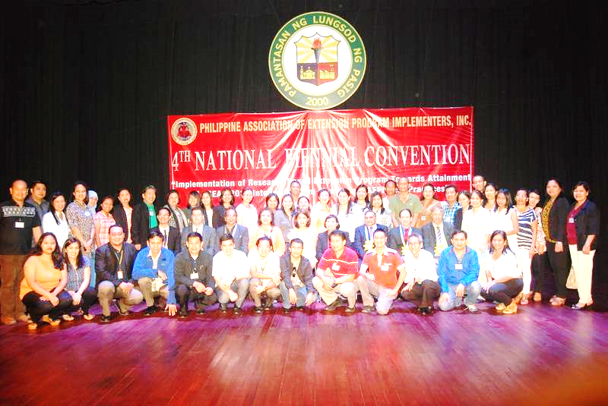
PAEPI Major Activities
01
National & Board Planning
02
2008 1st Biennial/GMA
03
2014 1st International
1989-2006- annual GMA.
2008- the 1st PAEPI Biennial Conventions/GMA (CU-2008) , ASU (2010), MAAP (2012),PLP (2014) & SBU (2021)-5th Biennial
PAEPI started 1st Annual Intl Convention & 4th Biennial hosted by PLP (2014) . Succeeding hosts : SBU (2015) , MAAP,UMAK/AMEA (2017), UP Diliman (2018) , DLSU(2019) & PLP (2021)
Led by Incumbent Presidents
5th
Biennial Convention and Oath taking Ceremonies
“Forging Local and Global Partnerships towards Sustainable Initiatives”

Slide 23
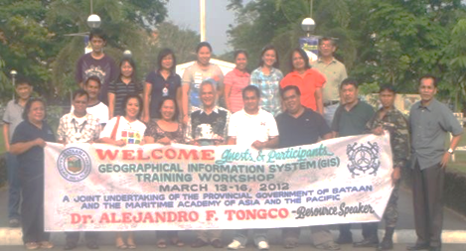
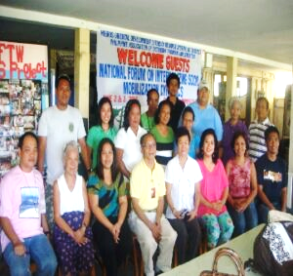
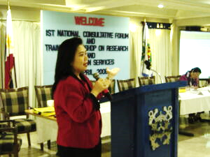
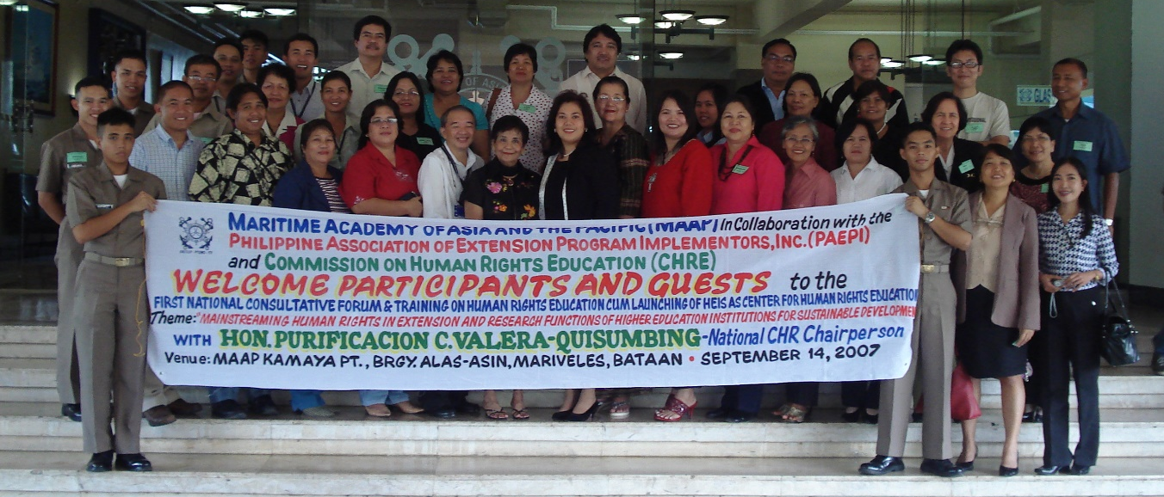
PAEPI Major Activities
04
National & regional seminar-workshops & capability trainings
Geographical Information System (GIS)
Social Mobilization
Extension Programme Implementation Enhancement
Human Rights Education
Research, Statistics and Extension Services
and other trainings based on needs
5th
Biennial Convention and Oath taking Ceremonies
“Forging Local and Global Partnerships towards Sustainable Initiatives”

Slide 24
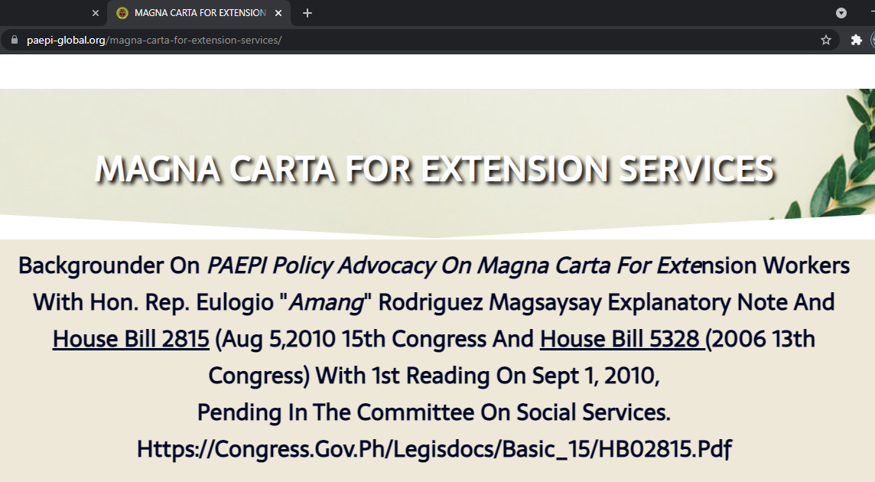
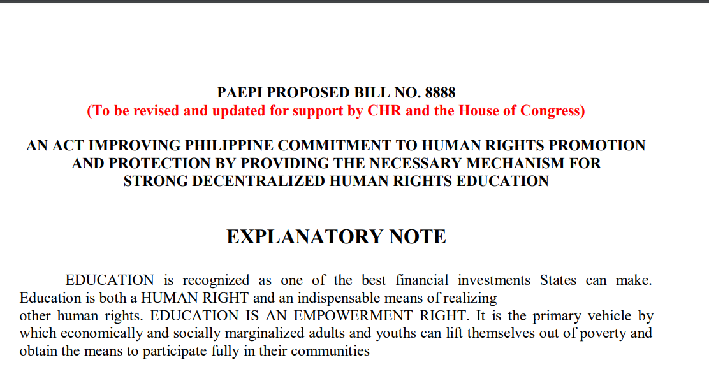
PAEPI Policy Advocacies
01
Magna Carta for Extension Services
02
NSTP
Manual Of Operation
03
Mechanism for Strong Decentralized Human Rights Education
5th
Biennial Convention and Oath taking Ceremonies
“Forging Local and Global Partnerships towards Sustainable Initiatives”

Slide 25
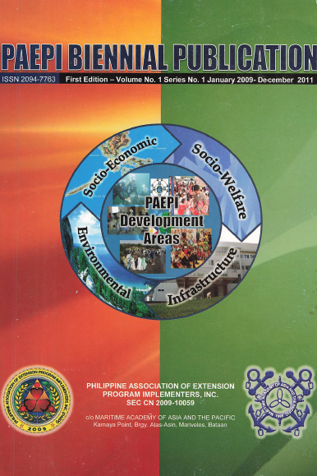
PAEPI Publications
PAEPI Biennial Publications
PAEPI Brochure
PAEPI GIS Primer
PAEPI Journals
5th
Biennial Convention and Oath taking Ceremonies
“Forging Local and Global Partnerships towards Sustainable Initiatives”

Slide 26
PAEPI Membership
The success of PAEPI depends on the quality of its human resources (leadership and membership)
Membership is open to all extension program implementers and institutions/organizations with extension agenda.
Initiatives from empowered members are encouraged
The 7 -point strategies for PAEPI membership expansion may be adopted
Organize chapters
institutional,
municipal,
provincial, and
regional
5th
Biennial Convention and Oath taking Ceremonies
“Forging Local and Global Partnerships towards Sustainable Initiatives”

Slide 27
PAEPI Membership Benefits
P
Presentation of institutional extension programs /practices/initiatives
R
Recognition on national & global level
A
Assistance to capability training or other support from PAEPI
Information updates on PAEPI activities and its partners’ activities
I
E
Endorsement as volunteer professionals & exchange experts
S
Service Commisionship as a Commission member/officer at PN, PCG or TAOIC-Interpol with officers rank
P
Publication of best practices in PAEPI Extension Services Journals
E
Establishment of alliances with other associations in the region and globally
Inclusion in the Membership Directory of Experts
I
5th
Biennial Convention and Oath taking Ceremonies
“Forging Local and Global Partnerships towards Sustainable Initiatives”

Slide 28
For more details
Visit
https://paepi-global.org/
THANK YOU
FOR YOUR ATTENTION!!!

